Slide 1

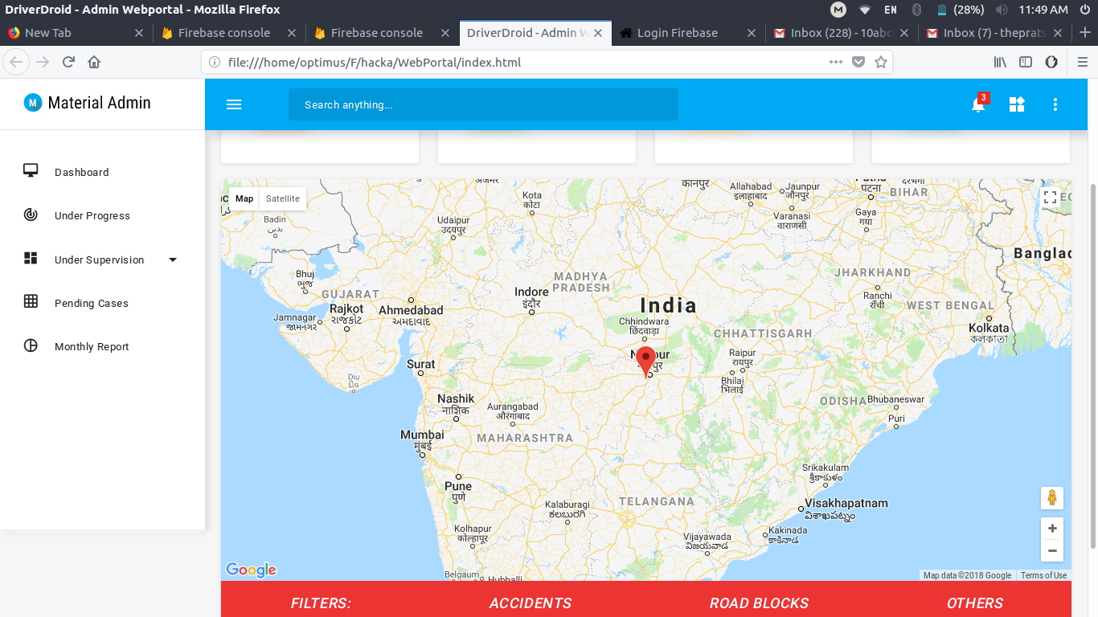

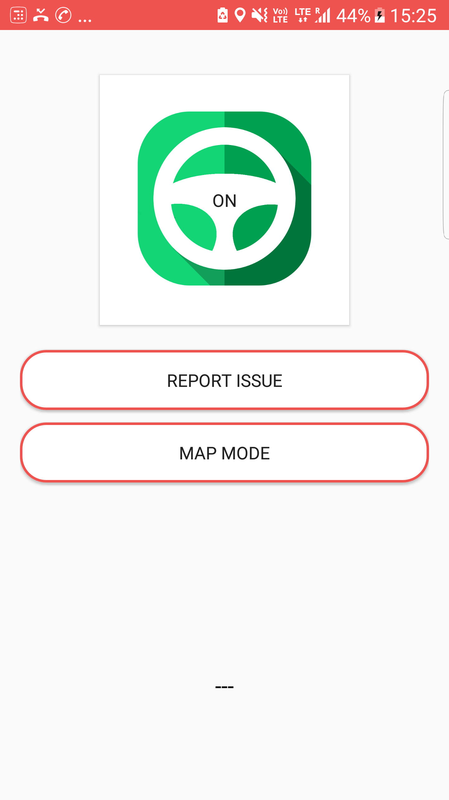
DriverDroid
Problem statement and
solution proposal
By - THE PRAATS

Slide 2
Outline
The Problem
Solution Proposal

Slide 3
Problem statement
To minimize the risks of accidents while attending mobile phone during driving.
This application would send the SMS about caller details and not the ringtone if the geo coordinates show the mobile shifting of the driver beyond 20 km/hr, say.
Before start of the journey, the Application shall make the Drivers mode enable

Slide 4
Solution description
The DriverDroid application will send notification to the caller stating that recipient is currently driving when the vehicle speed is above 20 km/hr.
Also driver or road user would be able to upload danger coordinates which can be retrieved by other road users.

Slide 5
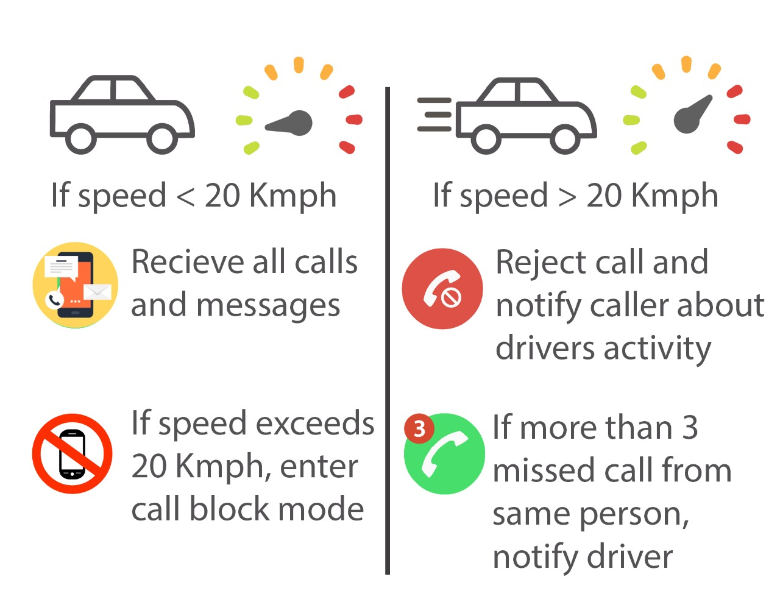
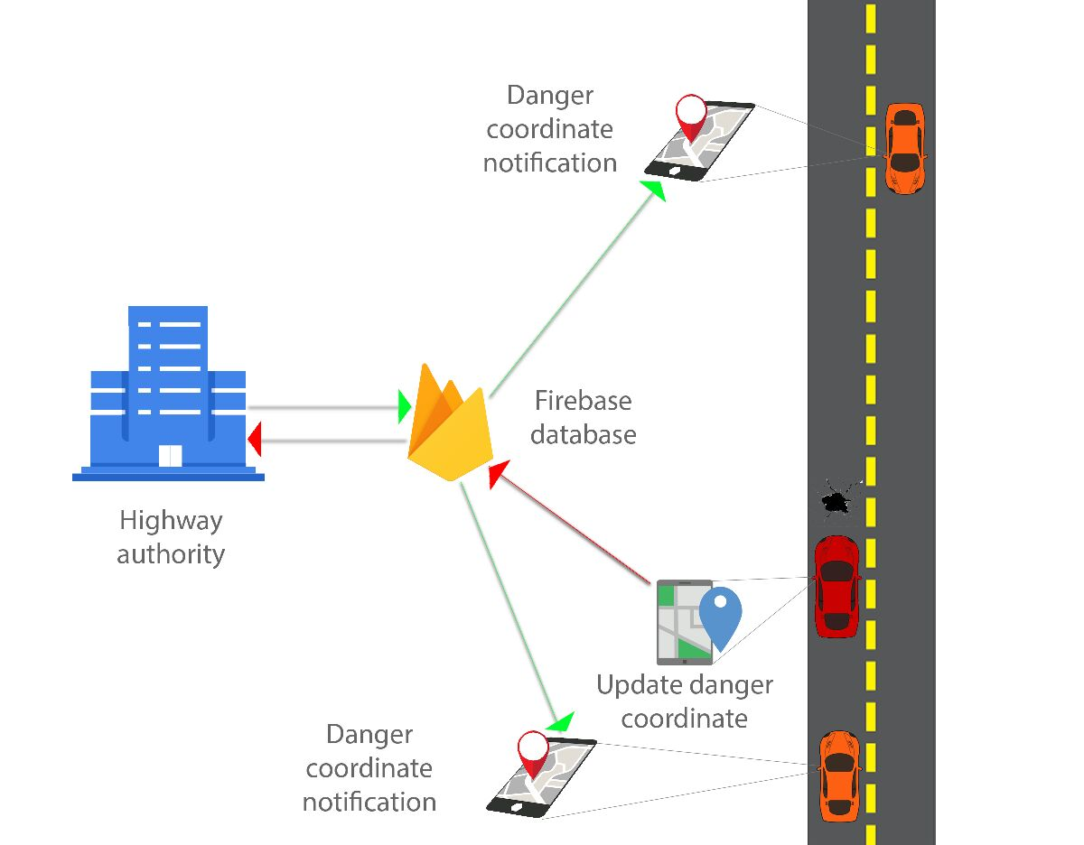
Diagrammatic Representation

Slide 6
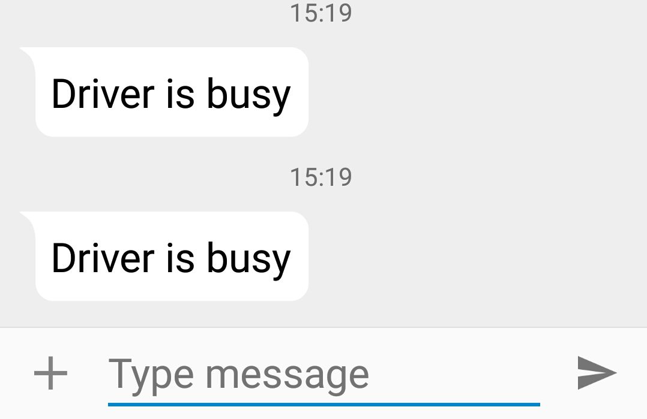
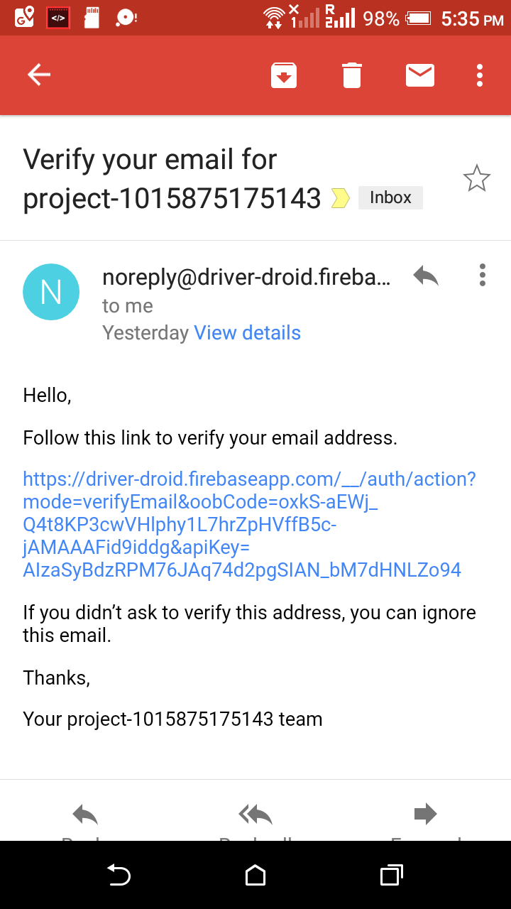
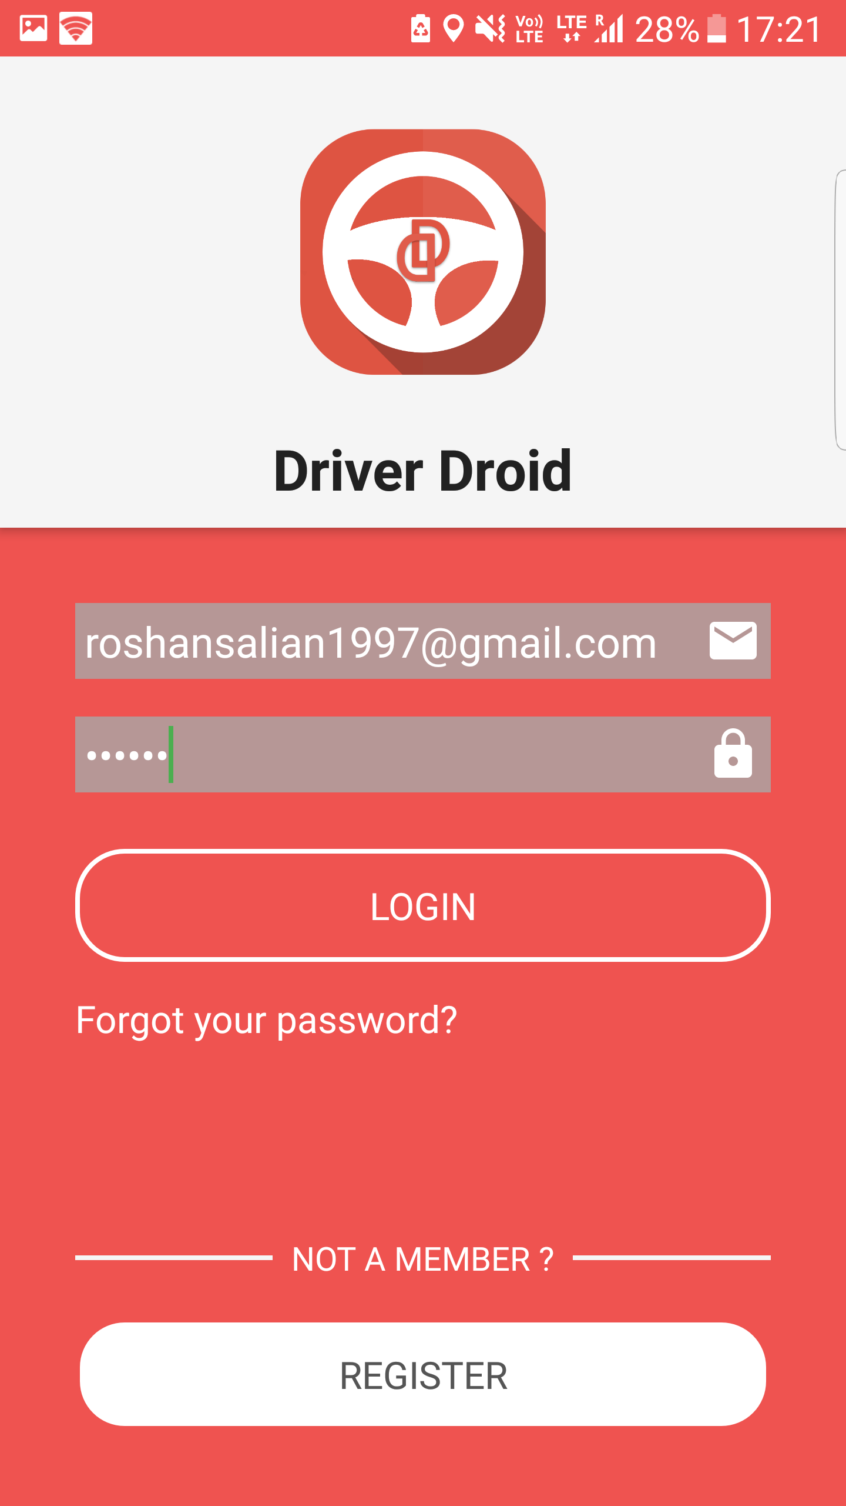
Features
Driver authentication and login.
Registration confirmed after email verification.
Send auto-reply SMS to caller when driver is driving.
Big single button for easy access

Slide 7
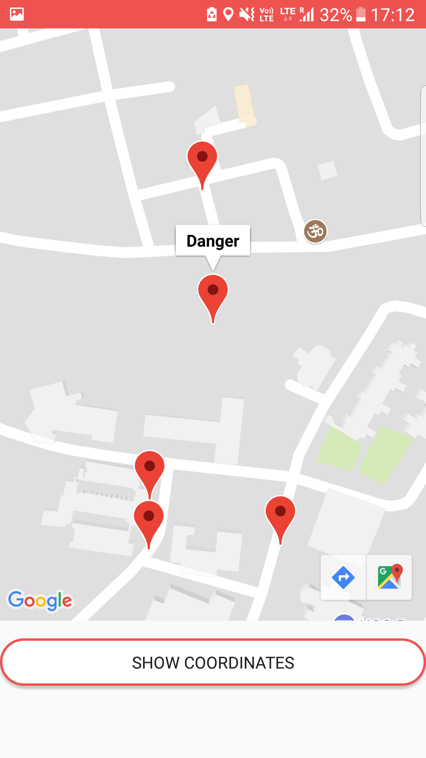
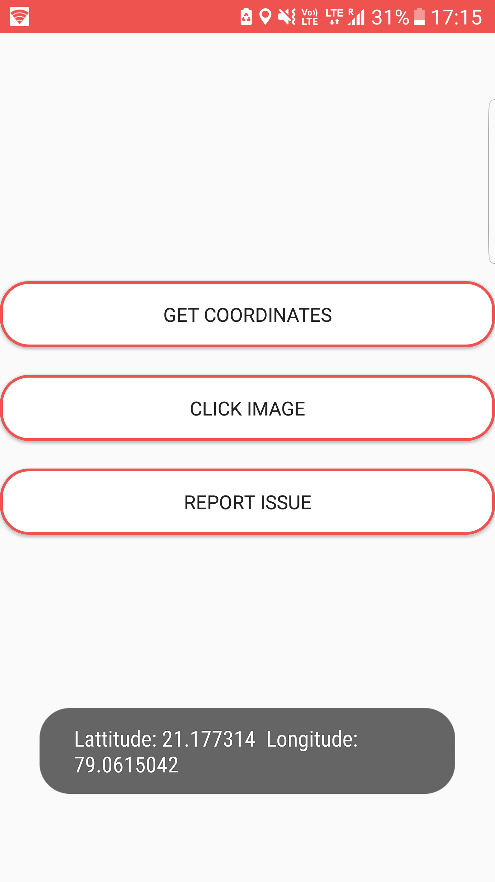
Features
Upload danger coordinates on web portal.
Web portal for contacting highway authority in case of emergency (accident, screaming, natural calamity)
Show danger coordinates on map.

Slide 8
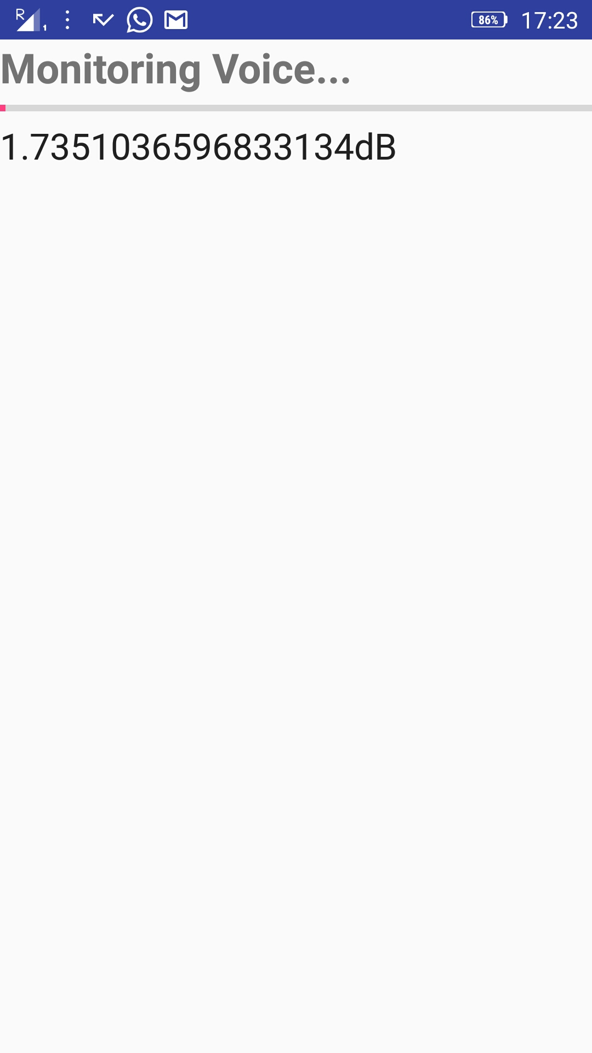
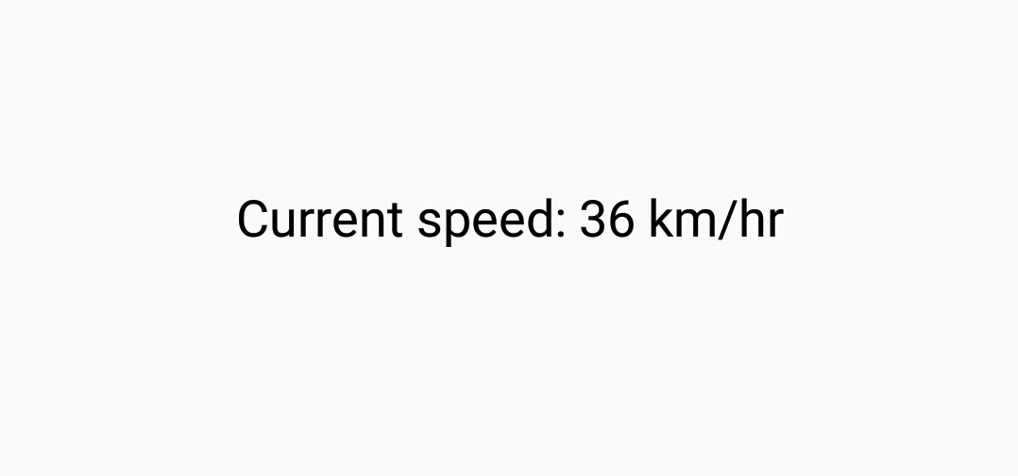
Future Scope
Alert driver on overspeeding (80 kmph) – without internet (use phone sensors)
Women Safety - Scream detection and inform police (secret feature, unknown to drivedroid users)
Emergency services - SOS call to appropriate officials (ambulance/ fire brigade/ highway authorities)

Slide 9
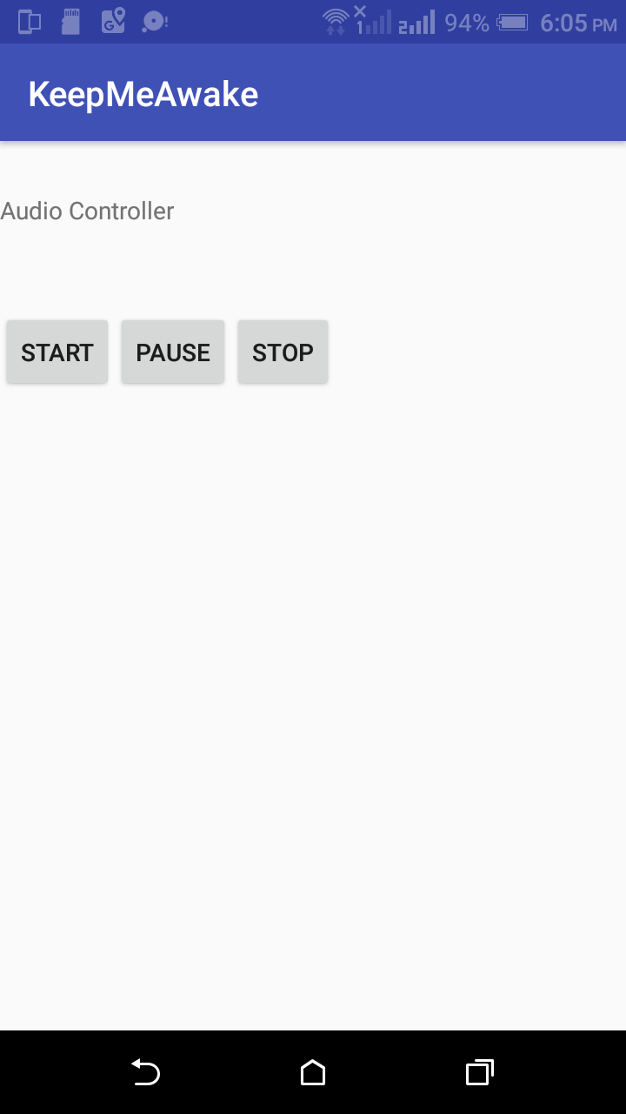
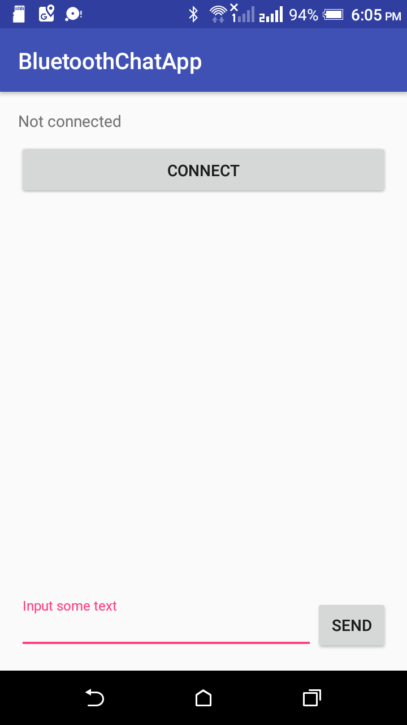
Future Scope
Keep me awake mode – sense if driver is sleeping using phone sensors and activate this mode to provide subliminal wake up messages, play jokes and interactive voice based games.
Fuel refill predictions based on data received via bluetooth from IoT sensors inside the car.

Slide 10
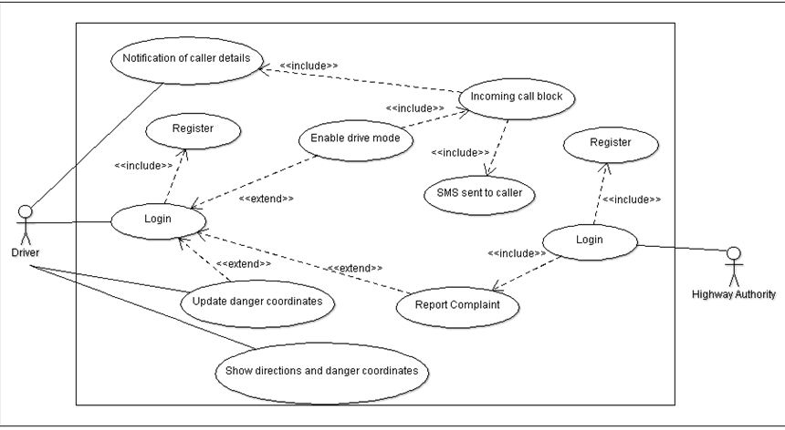
Use Case diagram

Slide 11
Thank you !

